Slide 1
Bridging Languages through Etymology:
The case of cross language text categorization
Neval Eden
İbrahim Çimentepe
Boğaziçi University
Fall 2013

Slide 2
Agenda
Problem
Model
Data
Results
Our extension
References

Slide 3
Problem
Cross language text categorization (CLTC)
  L_{s} L_{t}
Bag-of-words (BoWs) representation
  90% accuracy for monolingual categorization
  <50% accuracy for CLTC
Variations of BoWs with filtering, weighing...
Learning algoritms

Slide 4
Model
CLTC using word etymology
expense expensa spesa
Eng. Lat. Ita
    direct etymological antecedents (depth 1)
    up to a distance of N (depth 1,...,N)
  CLTC using word etymology
  + Latent Semantic Analysis (LSA)

Slide 5
Data
Etymological WordNet ¹
  6,031,431 entries
  2,877,036 words
  397 languages
  5 relations
    etymology etymological_origin_of
    is_derived_form has_derived_form
    etymologically_related
1 http://www1.icsi.berkeley.edu/~demelo/etymwn/

Slide 6
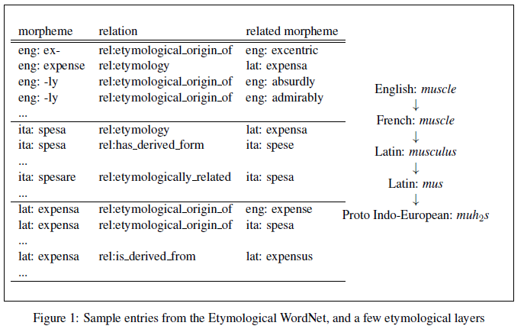
Data
Etymological WordNet

Slide 7
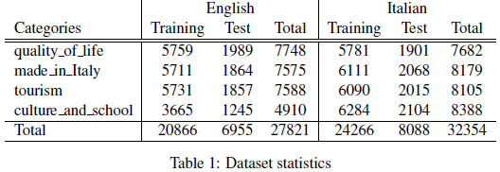
Data
News articles in English and Italian
    avg. document length: 300
    dataset statistics:

Slide 8
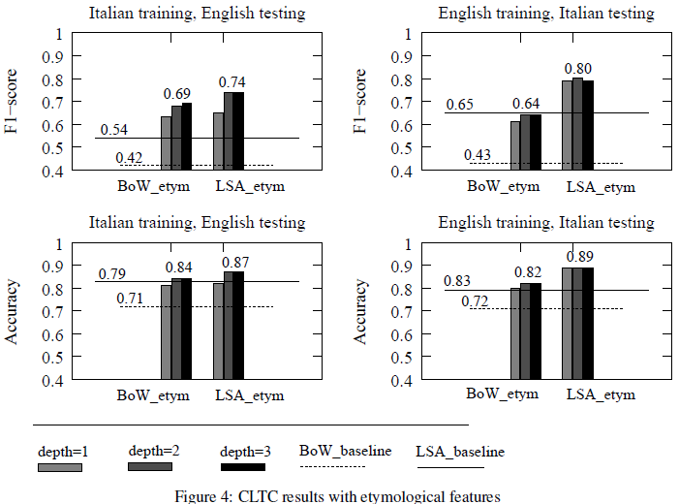
Results

Slide 9
Our extension
Application to English and Turkish CLTC
Monolingual textual entailment
Cross-lingual textual entailment

Slide 10
References
Proceedings of the 51st Annual Meeting of the Association for Computational Linguistics, pages 651–659, Soﬁa, Bulgaria, August 4-9 2013

